Slide 1
IS4432 Systems Design
Week 5 – Class and Method Design
Adapted by Janet Yu
115/11/08

Slide 2
Agenda
Why detailed design
Revision on classes
  Class, object, attributes, method/operation, relationship
Class & method design
  Encapsulation & information hiding
  Polymorphism & dynamic binding
  Inheritance
  Coupling & cohesion
115/11/08

Slide 3
Why Class and Method Design?
UML is the common language spoken among developers in different locations
Waste of time?
Jumping quickly into writing codes without careful design of classes and methods often result in system inefficiency and incapability
115/11/08

Slide 4
Why Detailed Design?
Actual code can be generated by modern CASE tool
Preexisting classes and components need to be understood, organized, and pieced together
Need to write some code and produce original classes that support the application logic of the system
115/11/08

Slide 5
Detailed Design
Classes from other layers are highly dependent on the problem-domain (PD) layer
If the problem-domain classes are designed correctly, the design of other classes will fall into place
115/11/08

Slide 6
Revision on Classes
115/11/08

Slide 7
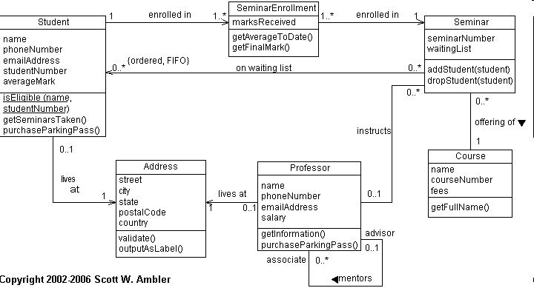
Class Diagram - Example
http://www.agiledata.org/essays/objectOrientation101.html
115/11/08

Slide 8
Class Diagram
Class
Object
Attributes
Method/Operation
Relationship
115/11/08

Slide 9
Classes and Objects
Class
  people/place/event/thing that the system will capture information
  defines both the data (attributes) and processes (methods) that each object contains.
  start with capital letter
  usually no space and special characters
  singular
Object
Attributes
Method/Operation
Relationship
115/11/08

Slide 10
Four Types of Classes/Objects
Things
Book
Movie
Album
…
People/Roles/Organization
Employee
Customer
Supplier
…
Transactions
Loan
Reserve
Order
…
Places
Branch
Region
Building
…
© Narsi Bolloju 2008
115/11/08

Slide 11
Class Diagram
Class
Object – instance of a class
Attributes
Method/Operation
Relationship
115/11/08

Slide 12



Class vs. Object
In Object-oriented Systems
Objects in the
Real-world
Classes
Objects
Book
B1, OOAD, Coad, 1999
B2, Java Prog, Deitel, 2008
…
…
E1, John, Kowloon Tong
E2, Mary, Central
…
…
Employee
115/11/08

Slide 13
Class Diagram
Class
Object
Attributes
  Describes the object
  Use lower case noun eg staffID, firstName
  Avoid adding ‘key’ attribute
  Avoid redundant attributes
  Derived attributes (denoted by placing a slash at front) refers to attributes that are calculated eg /age
Method/Operation
Relationship
115/11/08

Slide 14
Visibility of attributes
Public (+)
  Attribute is not hidden from any other classes
Protected (#)
  Attribute is hidden from all other classes except its immediate subclasses
Private (-)
  Attribute is hidden from all other classes
Usually, default is private
115/11/08

Slide 15
Class Diagram
Class
Object
Attributes
Method/Operation
  specify what object can do
  Same visibility logic as attributes. Default visibility is public
Relationship
115/11/08

Slide 16
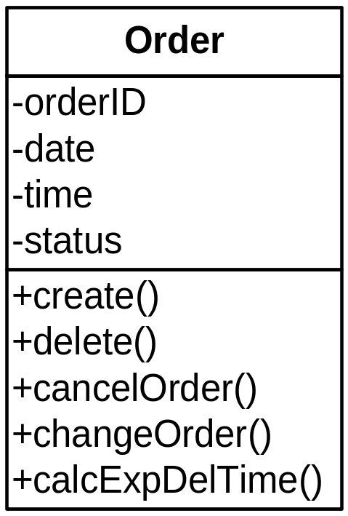
Operations
Constructor
  Creates object
Query
  Makes information about state available, does not alter the object
Update
  Changes values of some or all attributes
115/11/08

Slide 17
Naming methods
Methods available to all classes (eg create or delete an instance, set or return a value for an attribute) are generally NOT listed.
User
-Id -name -phone
+create() +delete() +getId() +getName() +getPhone() +setId(anId) +setName(aName) +setPhone(aPhone)
should not be listed (unless they have different meaning or parameters)
115/11/08

Slide 18
Class Diagram
Class
Object
Attributes
Method/Operation
Relationship
  Generalization
  Aggregation
  Association
115/11/08

Slide 19
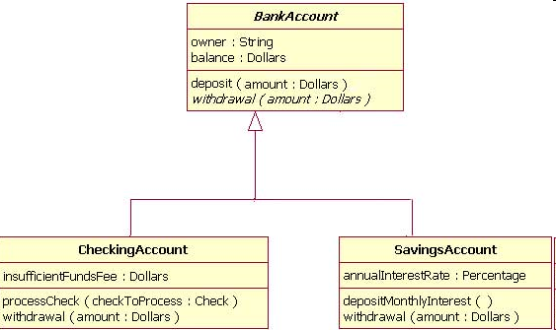
Generalization and Inheritance
a subclass inherits attributes and operations from a superclass
“A kind of”,
“is a”, “is type of”
http://www.ibm.com/developerworks/rational/library/content/RationalEdge/sep04/bell/
115/11/08

Slide 20
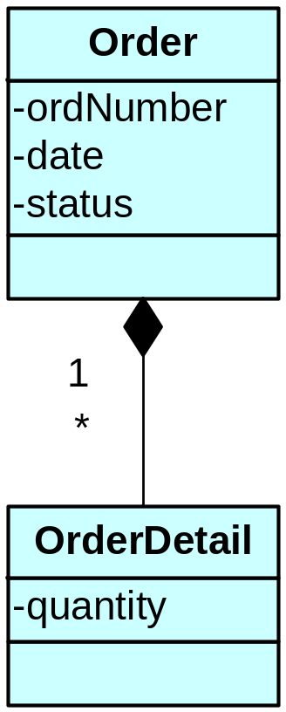

Aggregation
Aggregation classes comprise other classes
“a part of”
eg door is part of car
115/11/08

Slide 21
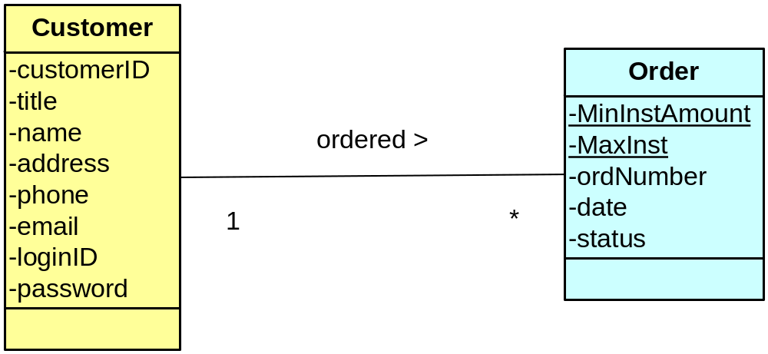
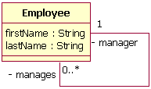
Associations
Relationship between classes
  Verb phrase
Class can be related to itself (role)
  Eg an employee is a manager of
  another employee
115/11/08

Slide 22
Multiplicity
Multiplicity
  Exactly one 1
  zero or more 0 .. *
  one or more 1 .. *
  zero or one 0 .. 1
  specified range 2 .. 4
  multiple disjoint ranges 1 .. 3, 5
115/11/08

Slide 23
Class Attribute
Attribute applies at the class level
  Class Attribute! Underline it!
Order
minAmount seasonalDiscount orderID date time amount
115/11/08

Slide 24
Class vs. Object Methods
Object methods (operate on a single object)
  changeOrder(), calcOrderAmount(); CalcAge(); isEligibleForLoan(); totalCommEarned(); assignToProject();
Class methods (operate on class or several objects)
  findOrder(); countOrders(); deleteLastMonthsOrders(); findEmployee(); numberEligibleForLoan();
  If method is on a collection of instances, Class Method! Underline it!
Order
orderID date time amount
calcAvgAmount() findOrder() newest Order()
115/11/08

Slide 25
Method Description
Customer
minAge customerID name dateOfBirth emailAddress password
validateEmailAddress()
  With email address as input, the system sends an email message with a link that customer can click to confirm validity of email address.
115/11/08

Slide 26
Class & Method Design
115/11/08

Slide 27
Encapsulation & Information Hiding
Encapsulation
  Combination of data and process into an entity
Information Hiding
  Only the information required to use a software module is published to the user
115/11/08
Notes:
Encapsulation & information hiding are interrelated in OOS
Encapsulation
The combination of process and data into a single entity
Information hiding
Only the information required to use a software module be published to the user of the module
Information required to be passed to the module, and the information returned from the module is published
How the module implements the required functionality is not relevant
Combining encapsulation with the information hiding principle suggests that the information hiding principle suggests that the information or processes
The fact that we can use an object by calling methods is the key to reusability because it shields the internal workings of the object from changes in the outside system, and to keeps the system from being affected when changes are made to an object
The only information that an object needs to know is the set of operations, or methods, that other objects can perform and what messages need to be sent to trigger them

Slide 28
Polymorphism & Dynamic Binding
Polymorphism
  A message can be interpreted differently by different classes of objects
Dynamic Binding
  Sometimes called late binding
  Delays typing or choosing a method for an object until run-time
115/11/08
Notes:
Polymorphism and dynamic binding
Polymorphism: the same message can be interpreted differently by different classes of objects
Insert a patient means something different than inserting an appointment → different pieces of information need to be collected and stored
“Draw yourself” to a square, circle and triangle
Polymorphism made through dynamic binding
Dynamic binding: a technique that delays typing the object until run-time → specific method that is actually called is not chosen by the OOS until the system is running
Static binding: type of object would be determined at compile time.

Slide 29
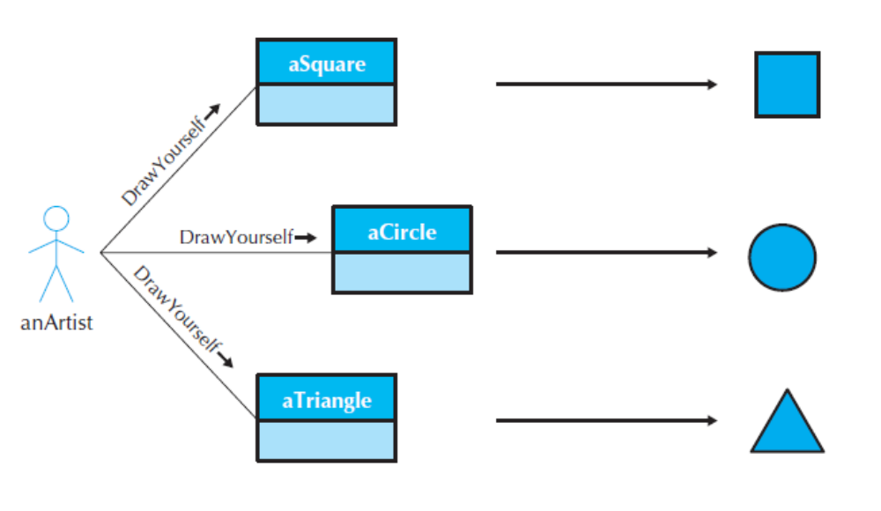
Polymorphism & Dynamic Binding
115/11/08

Slide 30
Polymorphism
Example
  calcFine() message is interpreted by objects of Book, Periodical, DVDMovie classes differently
  That is, there are several methods corresponding to calcFine() message & a method is selected depending on the object type or class that receives the message
115/11/08

Slide 31
calcFine
For Books: $1 * # of days late
For Periodicals: $2 for first 2 days and $4 for remaining days
For DVDs: $1 first day, $2 second day, $3 third day, …
For CDs: $0.5 first 3 days, $1 per day after 3 days
115/11/08

Slide 32
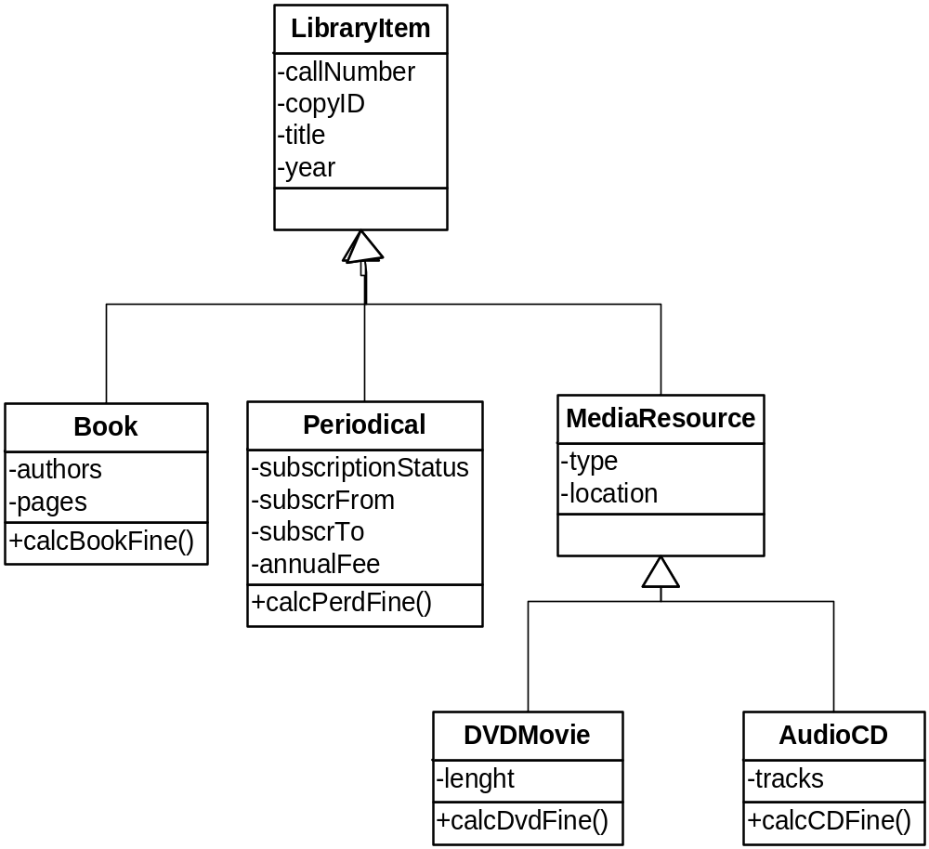
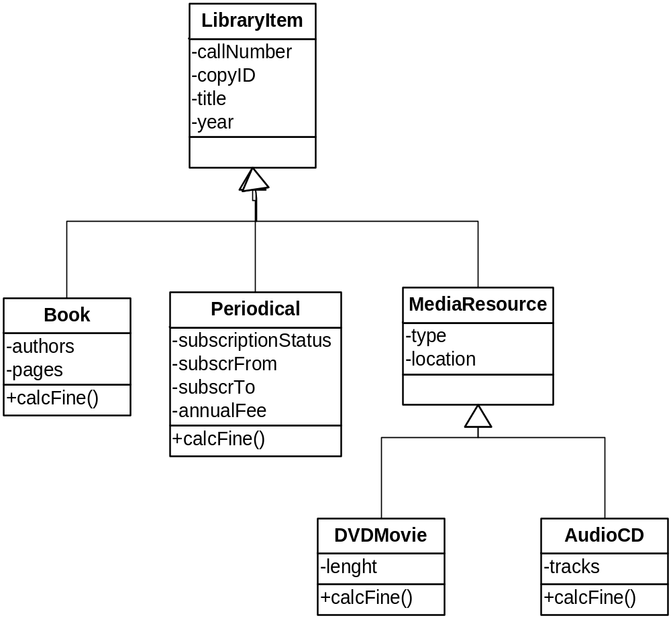
With and Without Polymorphism
+calcFine()
© Narsi Bolloju, 2008
115/11/08

Slide 33
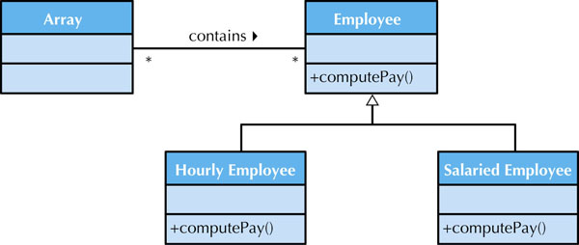
Polymorphism & Dynamic Binding
Figure 9.2
115/11/08

Slide 34
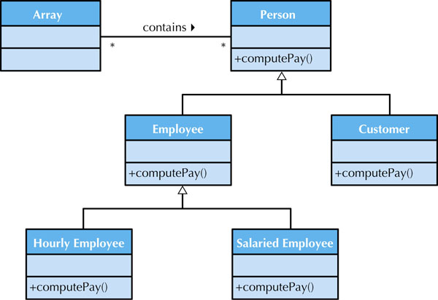
Polymorphism & Dynamic Binding
Ensure all methods with the same name implement that same generic operation!
115/11/08

Slide 35
Inheritance
Single inheritance vs multiple inheritance
Be aware of inheritance conflicts with redefinition capabilities
Some languages like Java allow method overriding.
115/11/08

Slide 36
Design Criteria
Coupling
Cohesion
115/11/08

Slide 37
Coupling
How interdependent or interrelated the modules
2 types
  Interaction coupling
  Inheritance coupling
115/11/08

Slide 38
Interaction Coupling
Deals with the coupling among methods and objects through message passing
Worst case is content coupled
  A method of one object refer to the inside (hidden parts) of another object
Should be minimized
Exception is : non-problem-domain classes must be coupled to their corresponding problem-domain classes
  Example: the report class is content coupled to its corresponding employee class
Problem-domain classes should never be coupled to non-problem-domain classes
115/11/08

Slide 39
Inheritance Coupling
Deals with how tightly coupled the classes are in an inheritance hierarchy
Many authors say this type of coupling is desirable
However, should not violate the encapsulation and information hiding principles
Inheritance is used only to support generalization/specialization semantics and the principle of substitutability
  Means the subclass should be capable of substituting for the superclass anywhere that uses the superclass
  E.g. anywhere we use the employee superclass, we could also use its secretary subclass
115/11/08

Slide 40
Cohesion
How single-minded a module is within a system
3 types
  Method
    Addresses the cohesion within an individual method
  Class
    Level of cohesion among the attributes and methods of a class
  Generalization/specialization
    Addresses the sensibility of the inheritance hierarchy
115/11/08

Slide 41
Identifying Opportunities for Reuse (1)
Design pattern
  Grouping of collaborating classes that provide a solution to a commonly occurring problem
  Useful in solving “a general design problem in a particular context”
Framework
  Composed of a set of implemented classes that can be used as a basis for implementing an application
115/11/08

Slide 42
Identifying Opportunities for Reuse
Class Library
  Similar to frameworks but also has a set of implemented classes that were designed for reuse
Components
  A self-contained, encapsulated piece of software that can be plugged into a system to provide a specific set of required functionalities
115/11/08

Slide 43
Group Exercise
Based on the information of the provided case, identify 8 object operations that support the required system functionality
Briefly describe the operations you have identified. An example is:
  validatePassword() – returns true if the password has length between 6 and 20, and contains at least one alphabet and one number
Share one of your operations & descriptions with the rest of the class
115/11/08

